Slide 1
Abyssal
Big (Unlabeled) Data:
A quest to create a fish detection dataset
Pedro Costa
Abyssal’s Head of Research | INESC TEC Researcher

Slide 2
Agenda
Abyssal
How to annotate your dataset
Creating a fish dataset
Notes:
My talk is divided in 3 main parts: I am gonna talk about Abyssal and some of our products and then I am gonna talk about two of our ongoing research projects: one for structure inspection and another for subsea SLAM

Slide 3
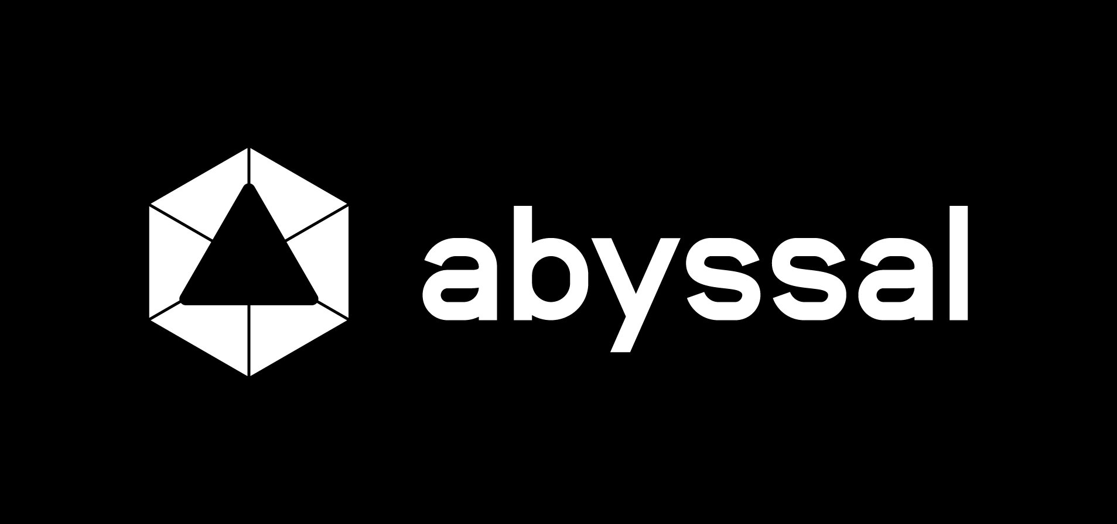

Slide 4
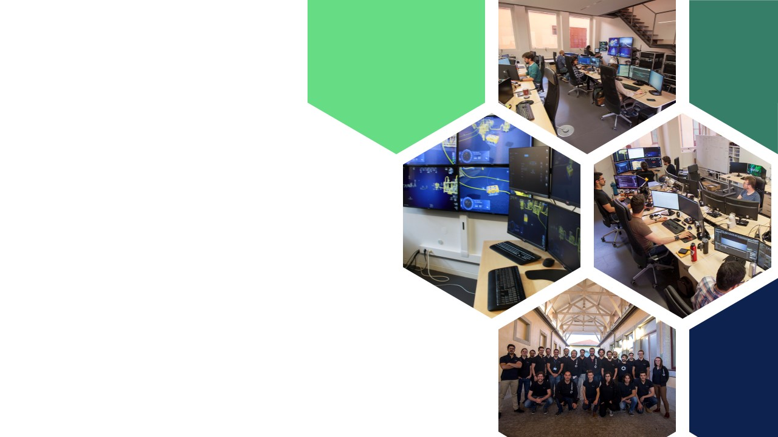

Intro
Founded in January 2012
Team of 25+ Software Engineers, 3D Artists, ...
Augmented Reality for subsea Remotely Operated Vehicles (ROVs)
Notes:
Who are we?
We started in 2012 working on Augmented Reality for subsea Remotely Operated Vehicles.

Slide 5
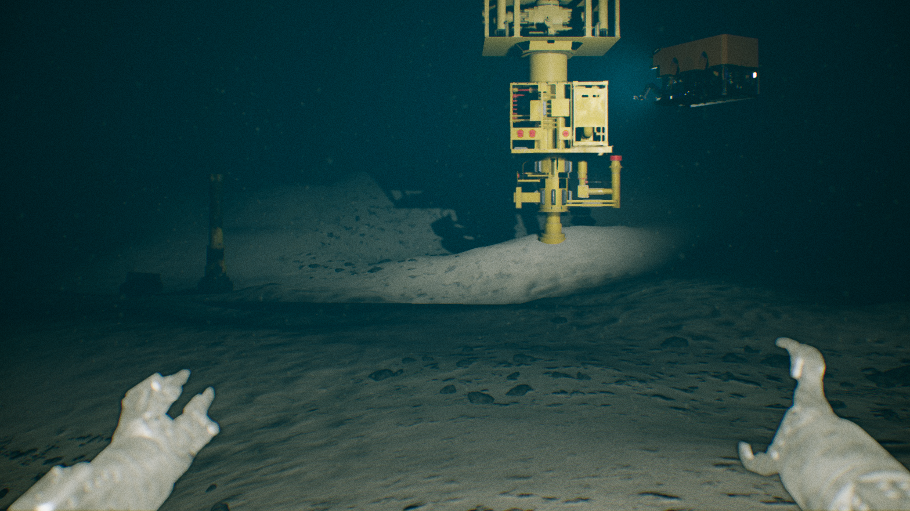
RESEARCH TEAM GOAL
Autonomous subsea operations!
Planning and ROV control for inspection and maintenance.
Notes:
Last year we started a research team to develop Artificial Intelligence solutions for the subsea.
Our main research focus is on Machine Learning and Computer Vision but we may work in NLP and we definitely will work on RL.
Because our long term goal is to completely automate subsea operations both on the planning side and the ROV control for inspection and maintenance.

Slide 6
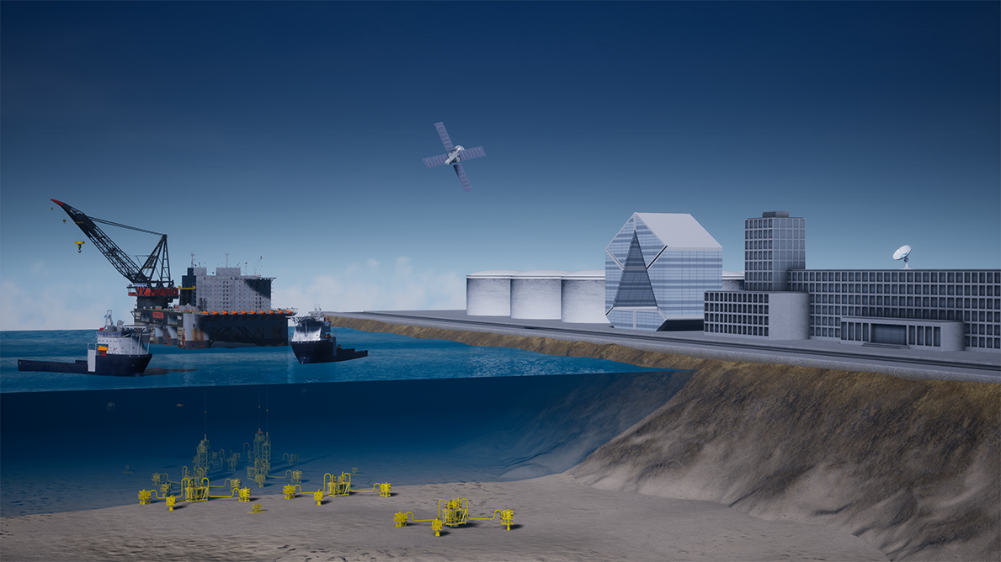
Notes:
But first, let me explain how the subsea operations work.
Our main clients work on the O&G industry and this is what a typical work field looks like. We have several underwater structures, typically at hundreds of meters below the surface (some over a thousand meters).
These structures require inspection and maintenance operations. These are typically performed by ROVs that are connected by a fiber optic cable to a vessel. The pilot controls the ROV from the vessel.
We help the pilots navigate in the subsea environment using AR.

Slide 7
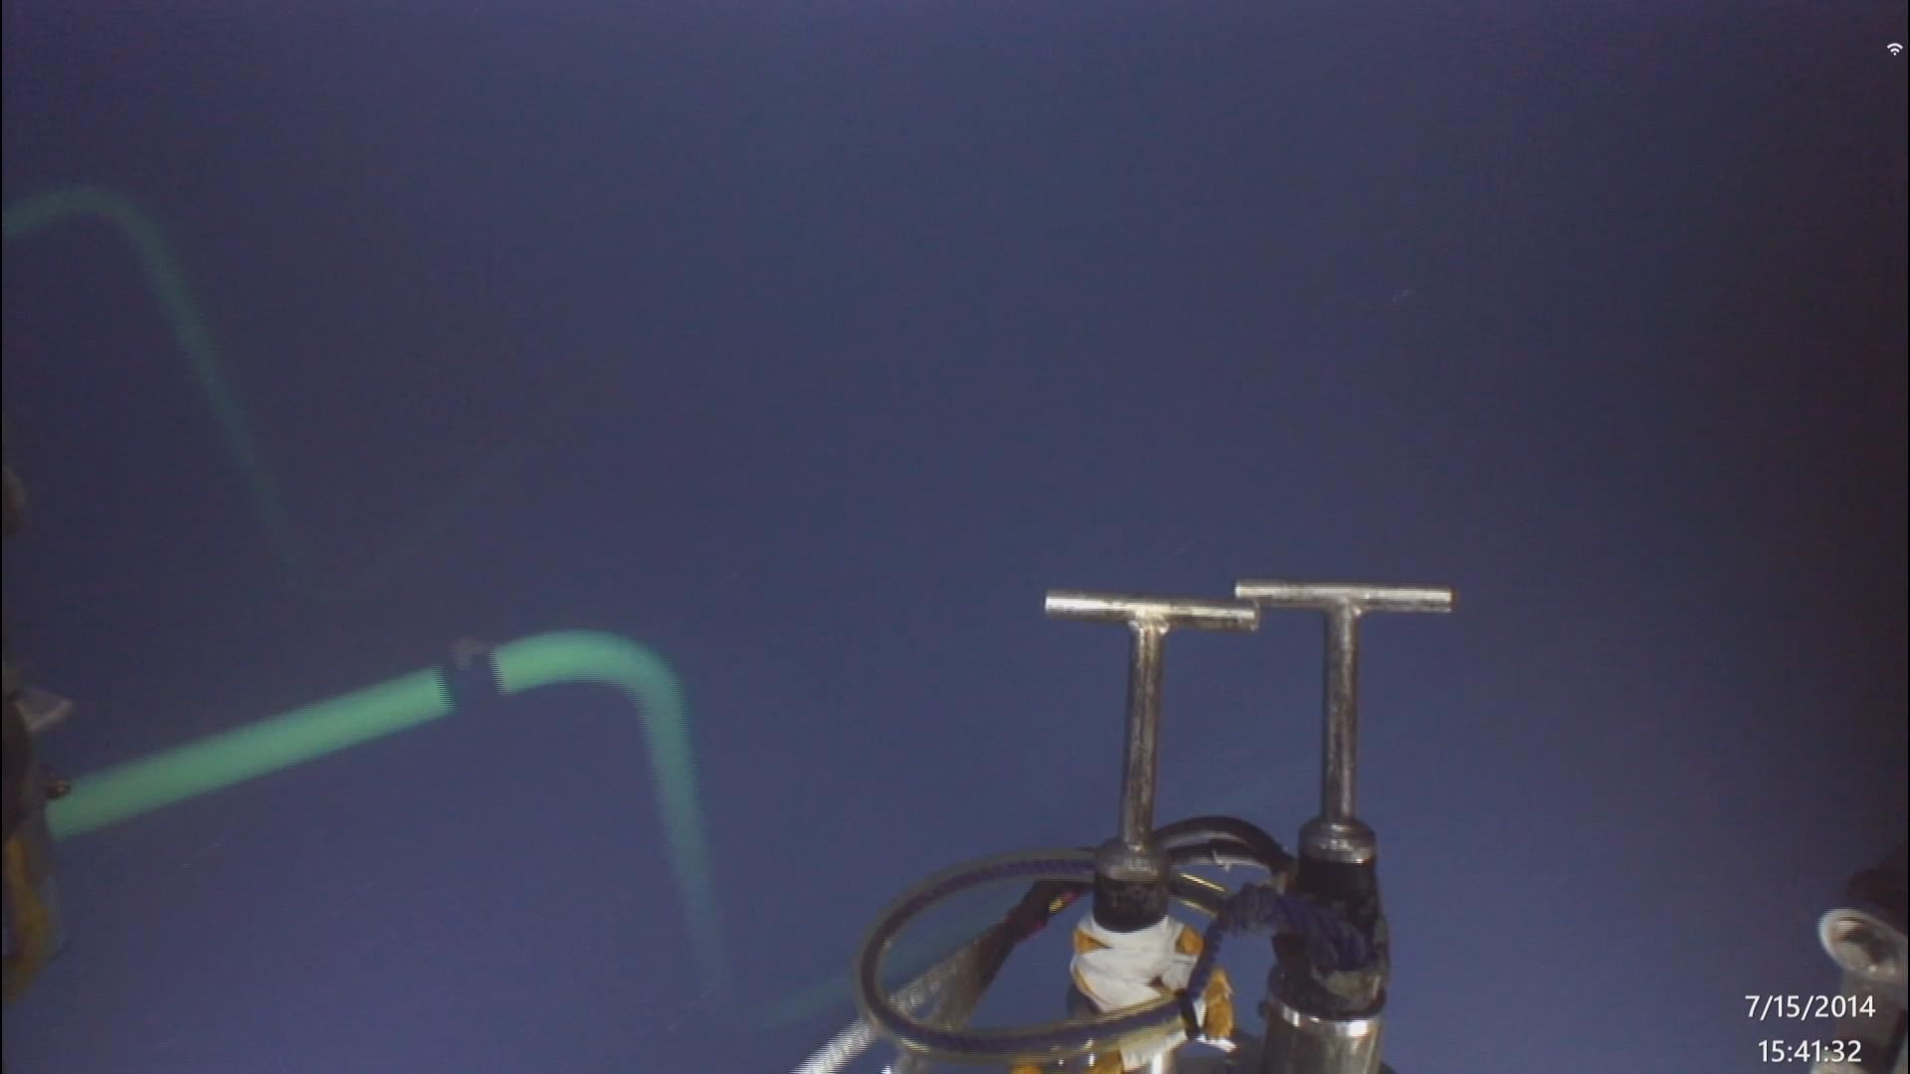
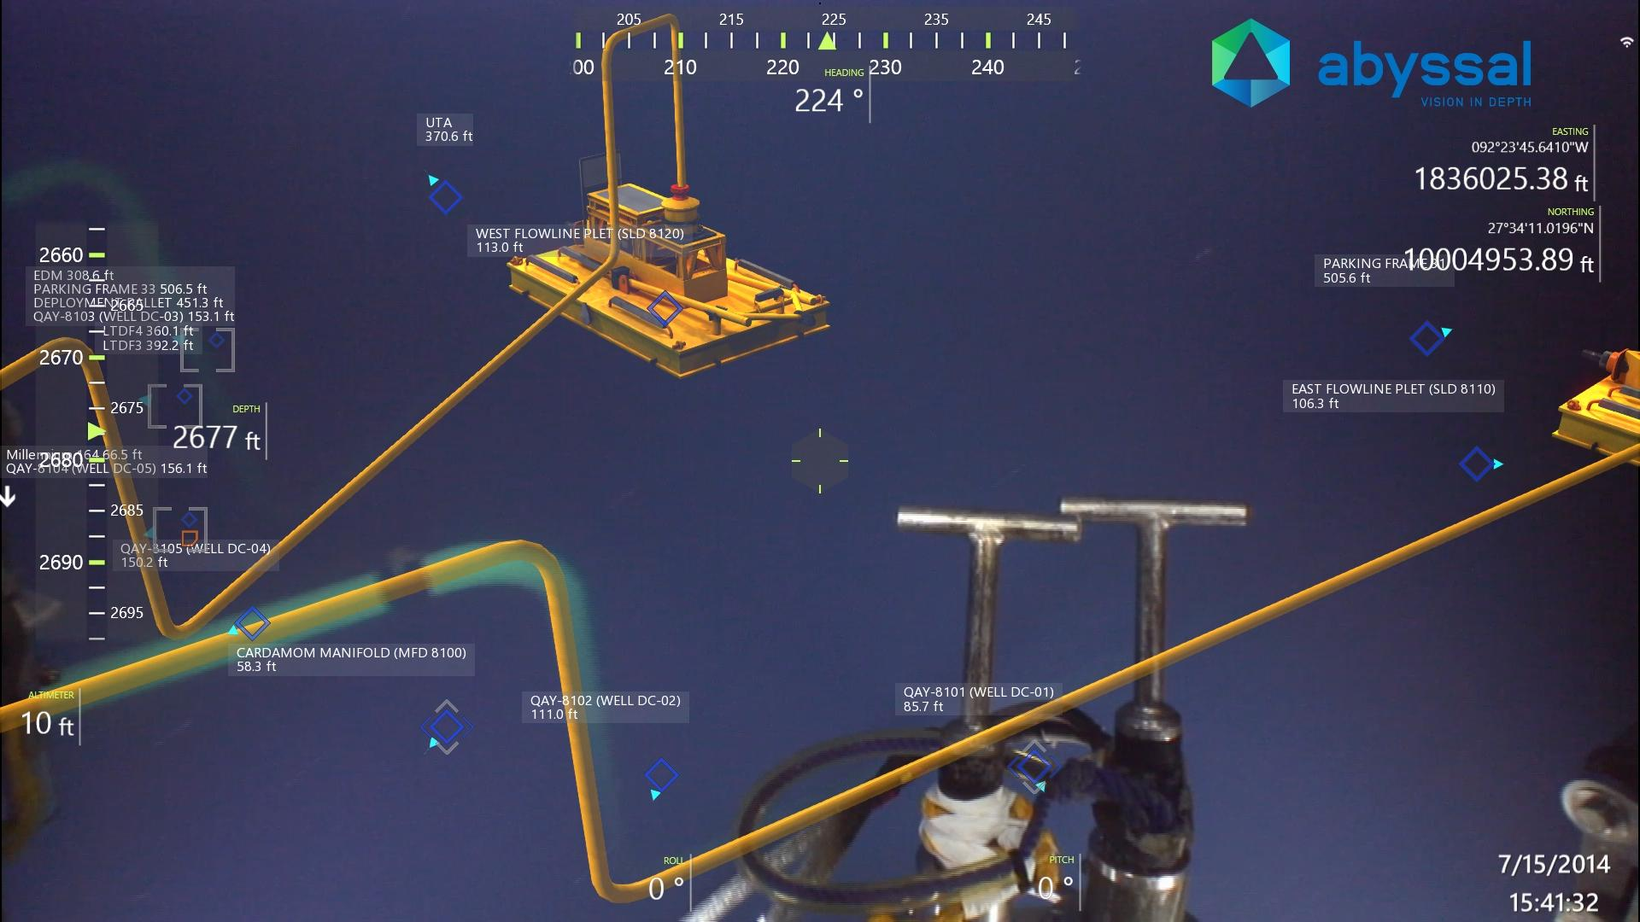
Real
Real
Real & Virtual
Notes:
Having that, we project the 3D elements into the virtual ROV camera and overlay that image onto the real image.
Then, we can actually add completely virtual elements to help the pilots navigate, like safe trajectories that they can follow.
We can also add 2D elements like the depth or position of the ROV.
You can see why this helps, because there is a lot more light attenuation under water and we can not see far away.

Slide 8
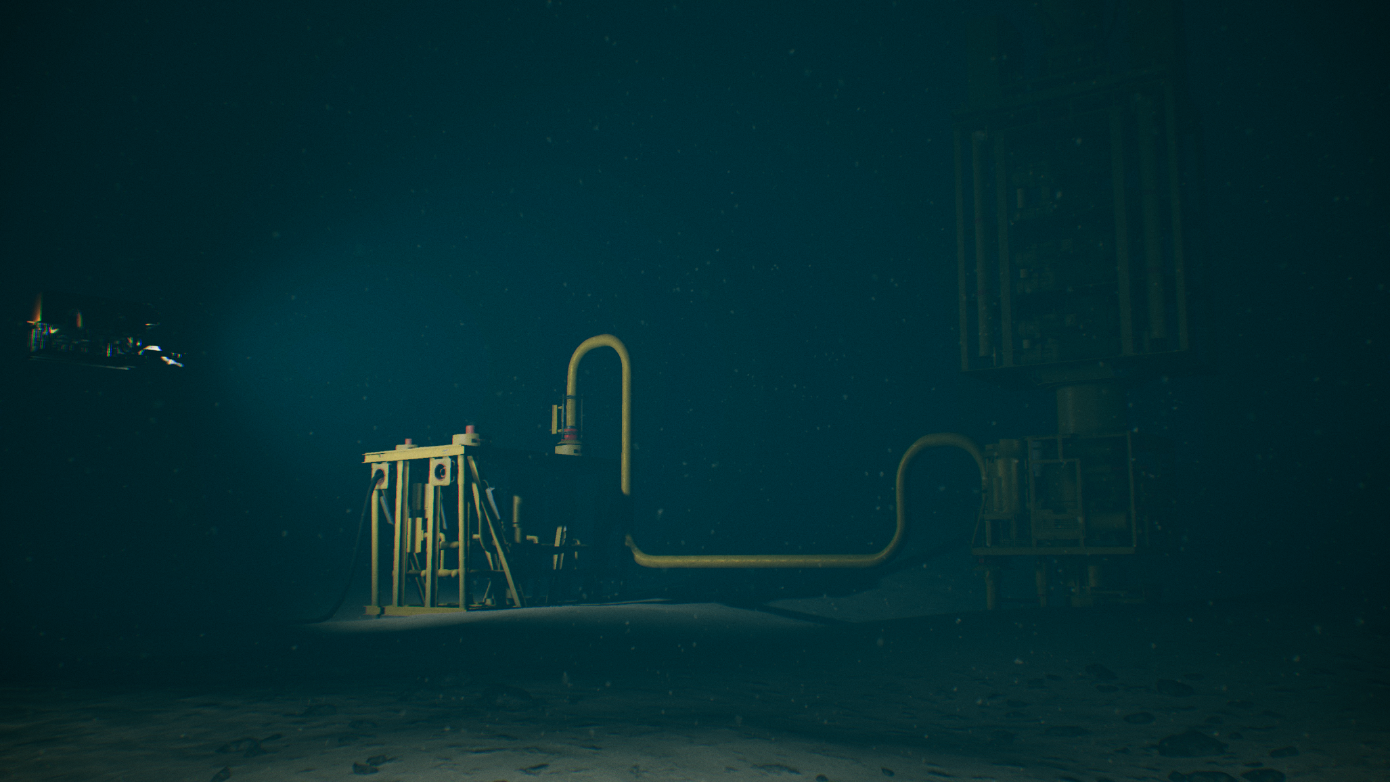
Simulator
Notes:
In the meantime we developed other products, but I am going to talk to you about one in particular: our subsea ROV simulator.

Slide 9
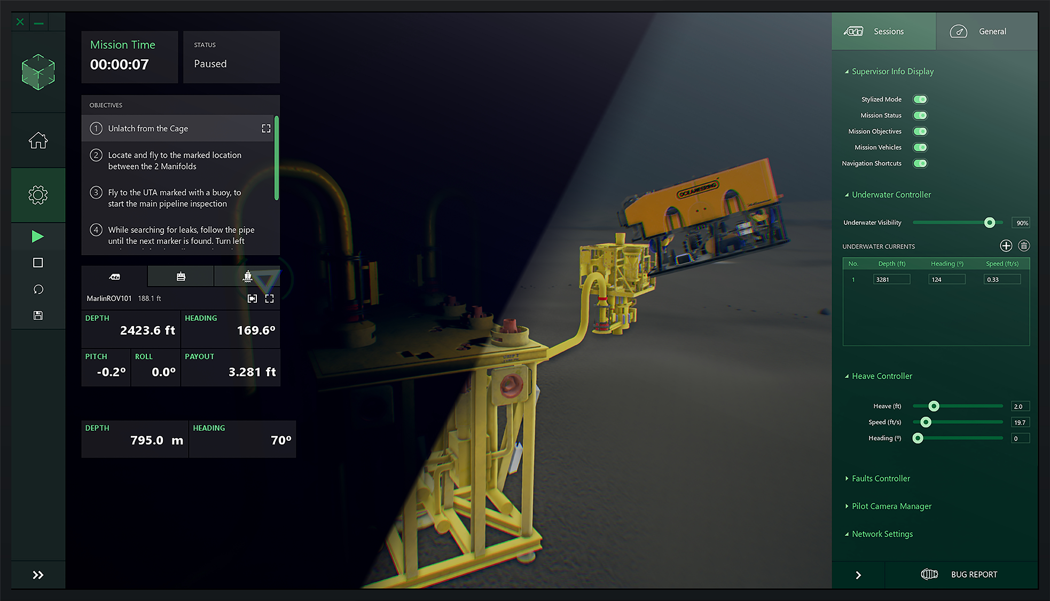
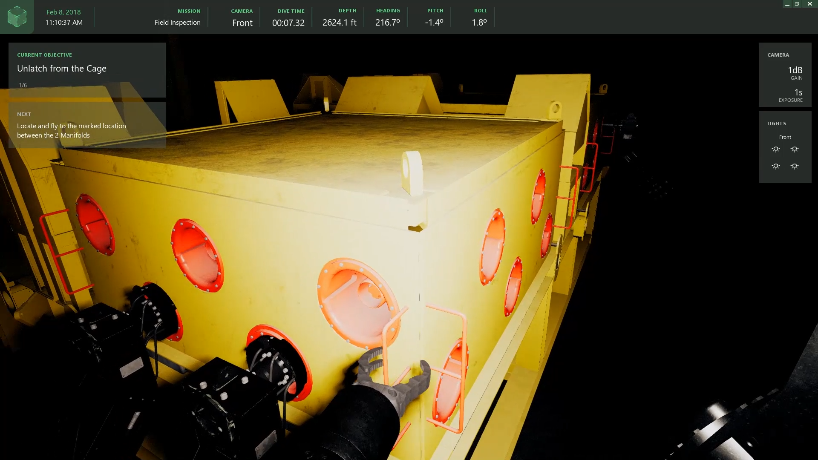
Train ROV pilots
Planning new operations
Machine Learning!
Notes:
We were asked to do this to test a particular ROV design but we can actually use this simulator to train ROV pilots, to perform virtual system integration tests and many other things.
We focused on the physics of the simulator, we can check if the ROV can take the weight of a certain tool, and we can even change the speed of the sea current and evaluate what is the maximum current at which the ROV can operate.
We can simulate an maintenance operation to find the optimal procedure, the sky is the limit...

Slide 10
Research Projects

Slide 11
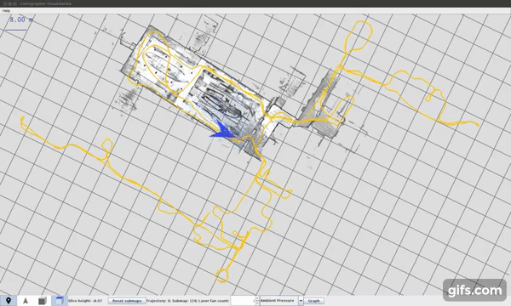
SLAM
SLAM - Simultaneous Localization and Mapping
Notes:
Submetemos também um projeto para desenvolver um sistema SLAM para o fundo do mar. SLAM significa Simultaneous Localization and Mapping e basicamente consiste em, através de vídeo, gerar um modelo 3D do ambiente e obter a trajetoria do robot nesse modelo.
Este tipo de projeto vai nos permitir operar em ambientes desconhecidos, porque deixamos de necessitar de criar o modelo 3D dos campos antes da operação, vai-nos reduzir o ruído do sensor de posicionamento do ROV no sentido de melhorar a nossa RA e também vai-nos abrir portas a novas funcionalidades como por exemplo interagir com o mundo, evitar colisões,... Também nos permite ter funcionalidades mais atrativas para outras aplicações e industrias como por exemplo investigação científica e aquacultura.

Slide 12
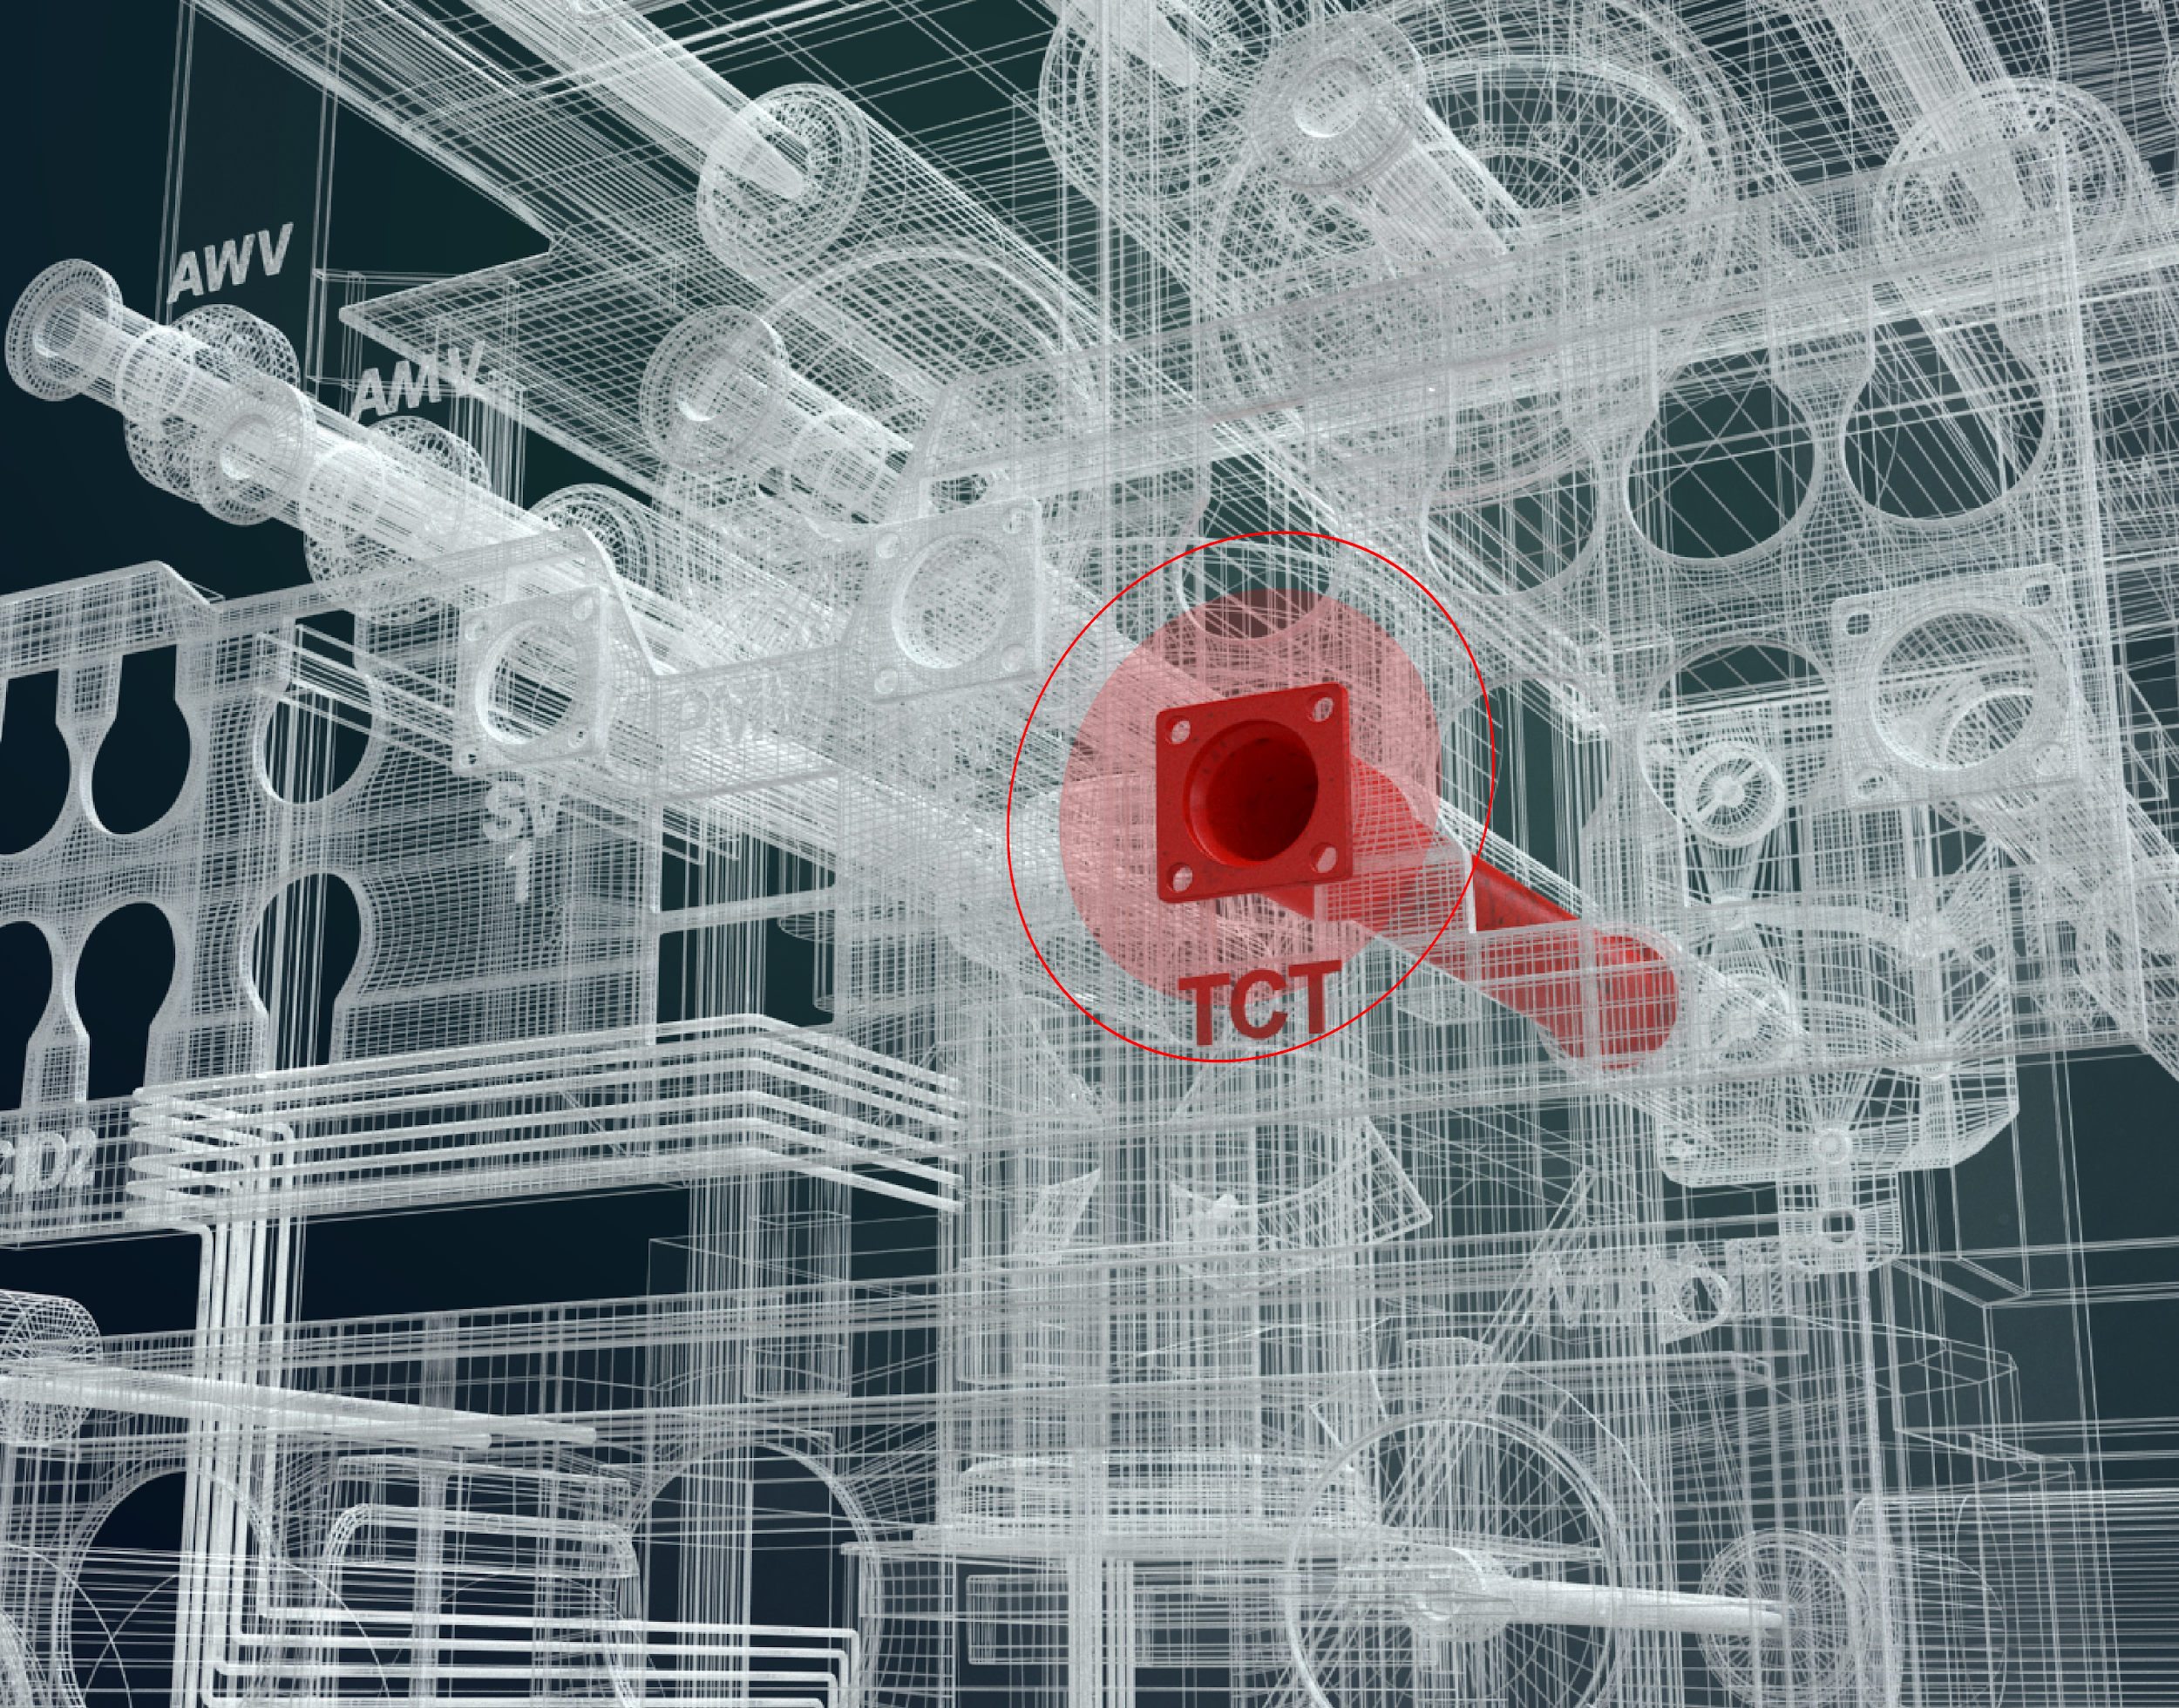
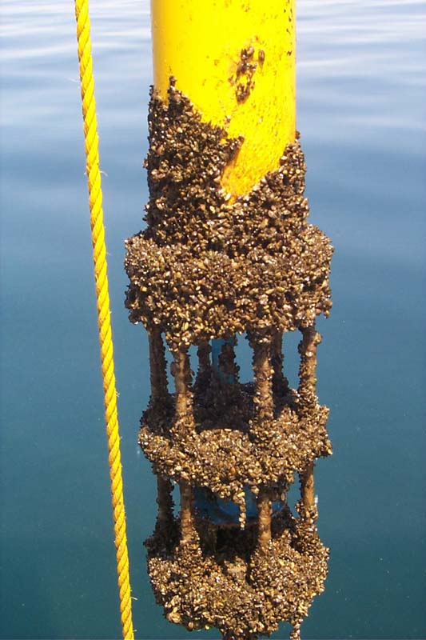
Anomaly Detection
Automatically detect anomalies in marine renewables’ subsea structures.
Biofouling
Sacrificial anodes
Leaks
...
Notes:
The main goal is to automatically detect anomalies in marine renewables’ subsea structures.
These anomalies may be biofouling, which is what we see in that figure. Bio organisms grow in the surface of the structures and damage them, so they need to be cleaned from time to time.
We want to detect when sacrificial anodes need to be replaced, these are highly active anodes that protect the main structure from corrosion.
We want to detect leaks

Slide 13
Problem Definition
Predict if a fish is visible in a given frame.
EMEPC gave us some of their videos:
3.9 TB!
More than 250 videos from 2008-2012.
Some with less than 10 min other more than 1 hour.
… Highly unbalanced!
Find anomalies fish in ROV videos!

Slide 14
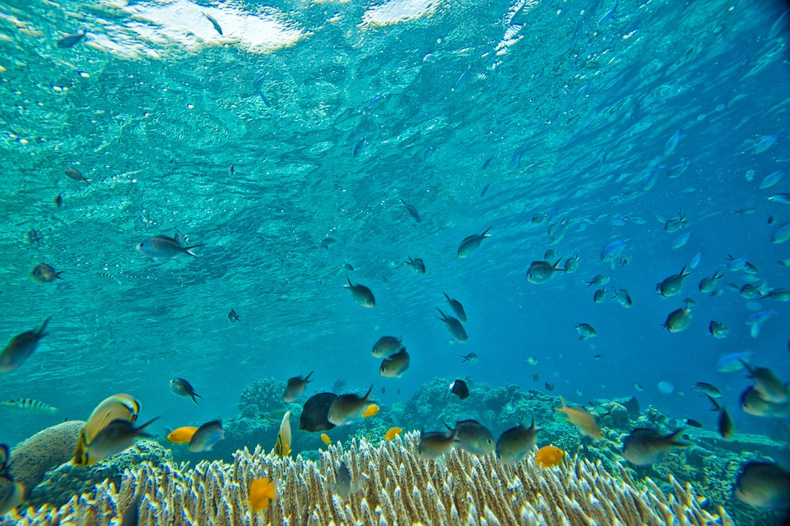
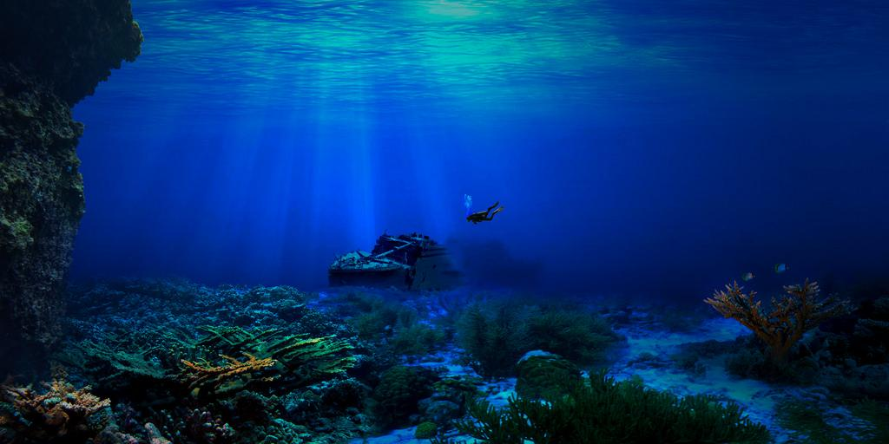
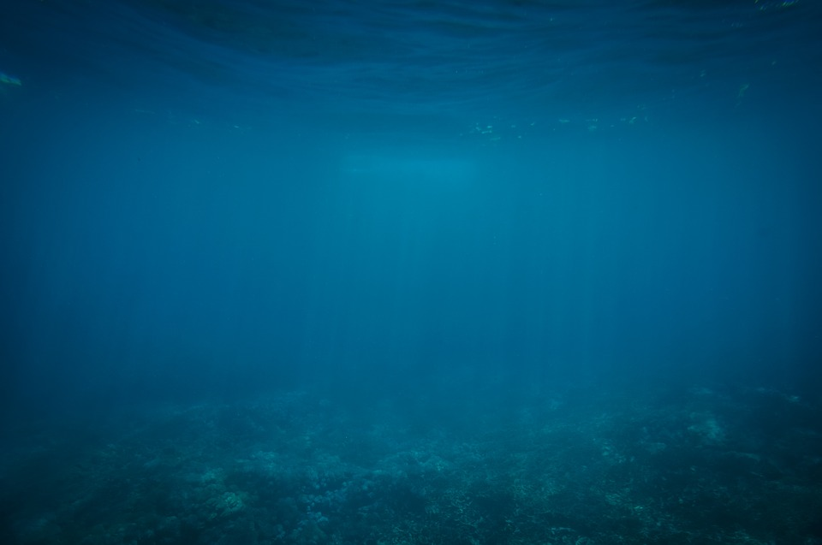
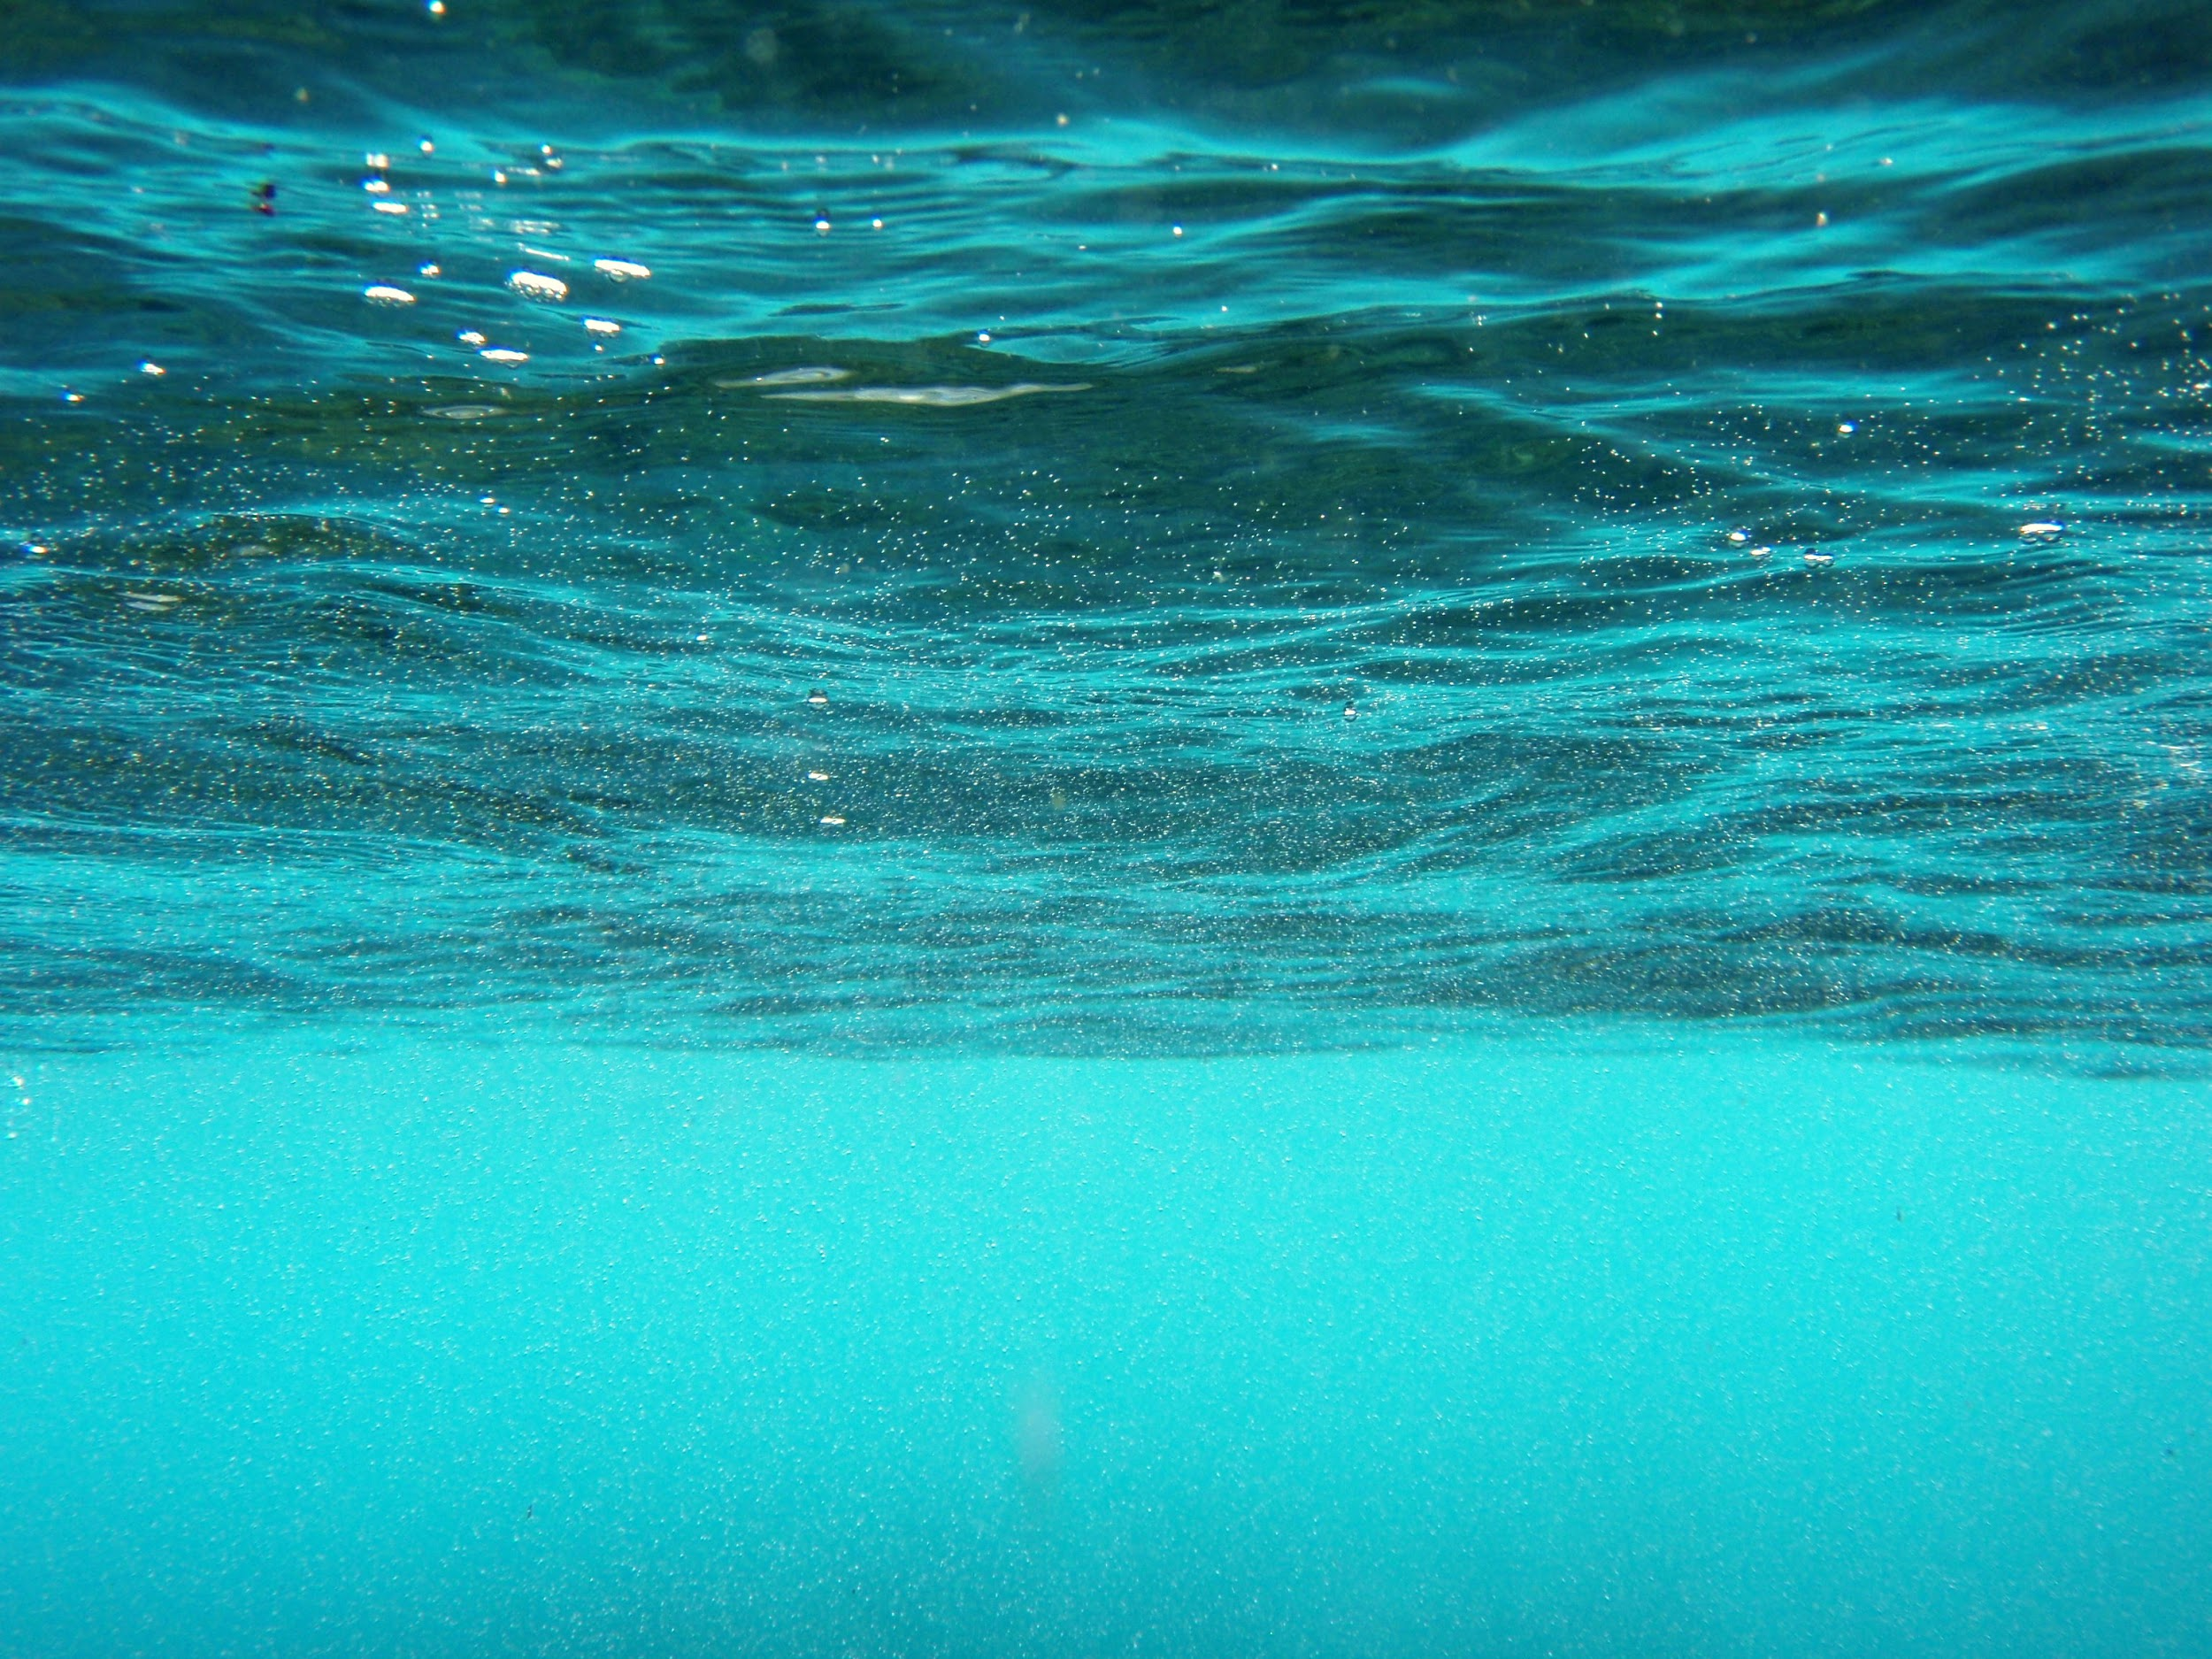
Research Question
What data point (frame/video/segment) do we sample next to be labeled?
?
Notes:
This is important not only for this particular problem but for future problems.

Slide 15

Typical approach
Is random sampling the best we can do?
Unlabeled Dataset
Random
Sample
Add
Labeled
Dataset

Slide 16
Random Sampling problems
Unbalanced Datasets
Repeated/Similar/Correlated examples

Slide 17
Active Learning
Use the model to sample new examples to be annotated.
Unlabeled Dataset
Run
Sample
Model
Train
Labeled
Dataset
Add

Slide 18
Intuition
Run
Sample
?
Train

Slide 19
Intuition
Run
Sample
Add
Train

Slide 20
Intuition
Run
Sample
Add
Train

Slide 21
Active Learning
Dataset
Sampling Method
Model
What do we need?
Notes:
Problem Definition/Motivation
Detect fish
Large number of unlabeled videos
Typical workflow: random sampling
Problem: Sample similar examples
Unbalanced dataset
Solution: Active Learning
What is AL
Choices. We want to evaluate if this works at all:
Dataset
Sampling Method
Model
Dataset: VOC (cat vs all) (unbalanced)
Sampling Method:
Predictive Entropy
Cross-Entropy?
Model: CNN (of course) (SqueezeNet)
Results: pre-trained
AP
Number Positive/Negative
Example Filipa sent me
Results: scratch
AP/AUC
Number Positive/Negative
Now to the fish dataset:
Tool to label
Caution:
Cross-entropy vs Predictive Entropy
Deep Learning learns the features:
They are all wrong
Of course this could be solved by labeling more images, but where is the fun in that?
Find regions of the feature space more likely to being wrongly classified:
Auto-Encoder

Slide 22
Dataset: VOC 2012
Solve the Cat vs No-Cat task.
Unbalanced: Only 7.53% training images contain cats.
5717 images
Train 571
Val 1029
Oracle 4117
Test 5823

Slide 23
Sampling: Predictive Entropy
Also known as Uncertainty Sampling.
Select the example x* that minimizes the predictive entropy:
y = model(x)
x* = arg min y * log(y) + (1 - y) * log(1 - y)
Just select the example that is closer to the decision boundary!

Slide 24
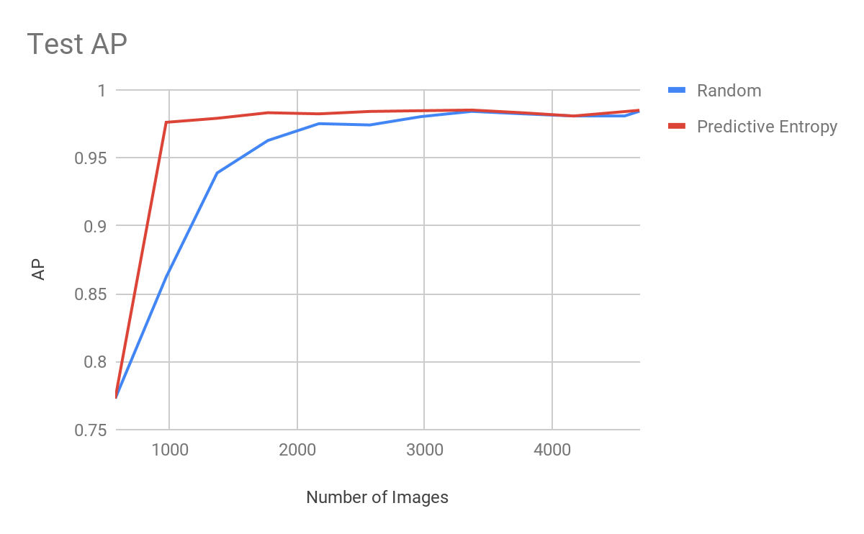
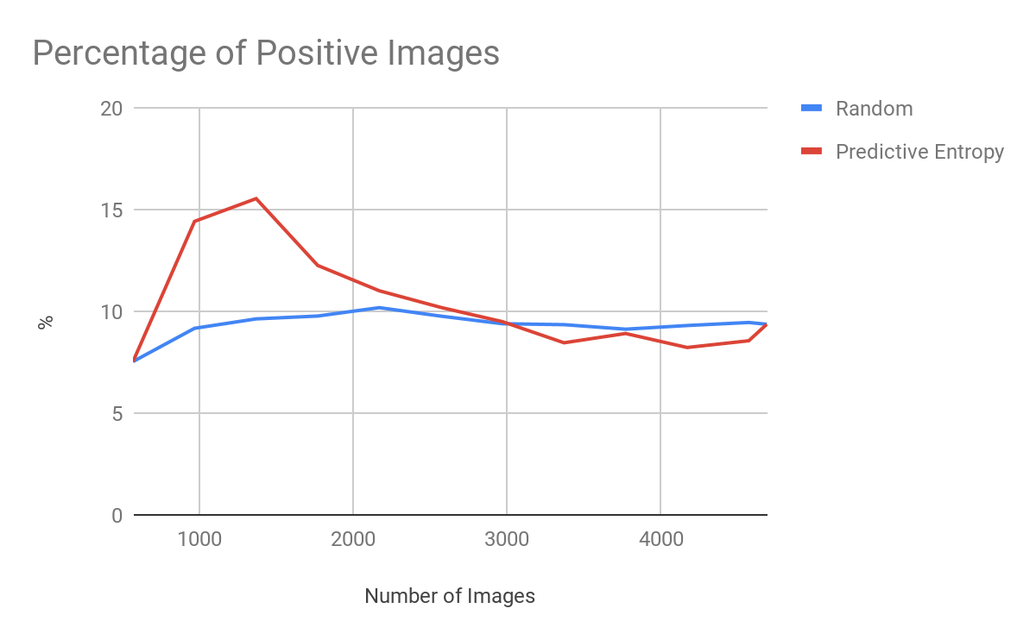
Results: Pre-Trained
ResNet50 pre-trained on ImageNet;
Sampling 400 images at each iteration.

Slide 25
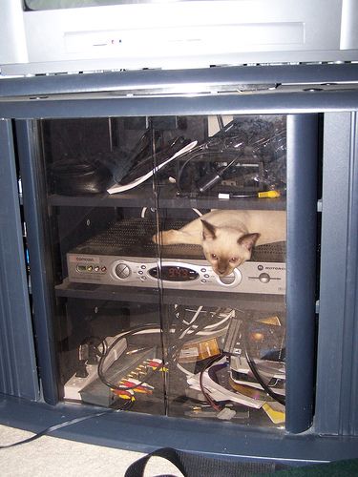
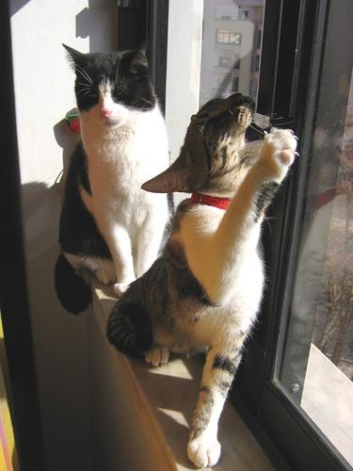
Examples
“Difficult” images are added first!
First Iteration
Last Iteration

Slide 26
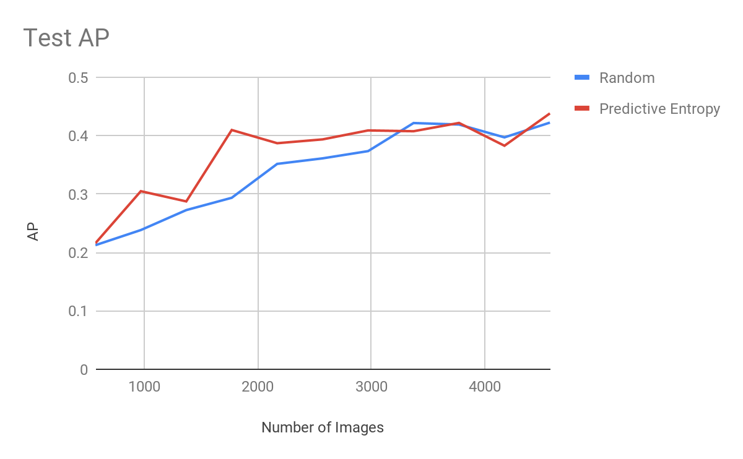
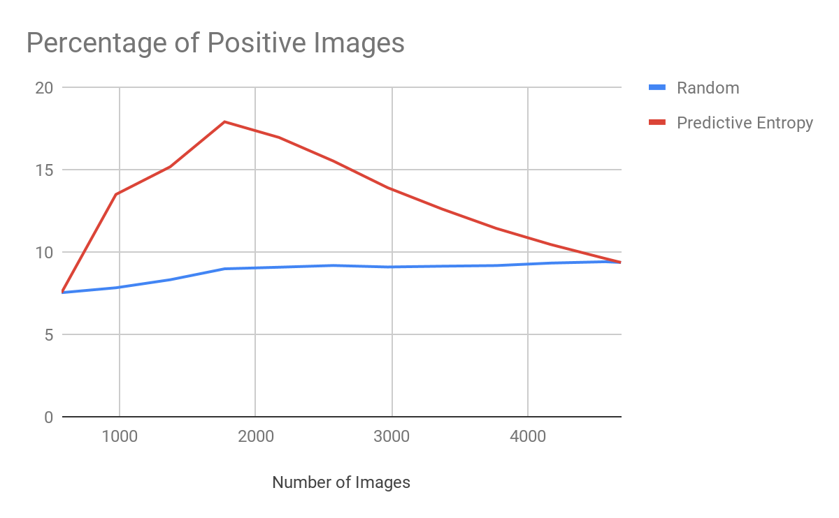
Results: Scratch
SqueezeNet;
Sampling 400 images at each iteration.

Slide 27
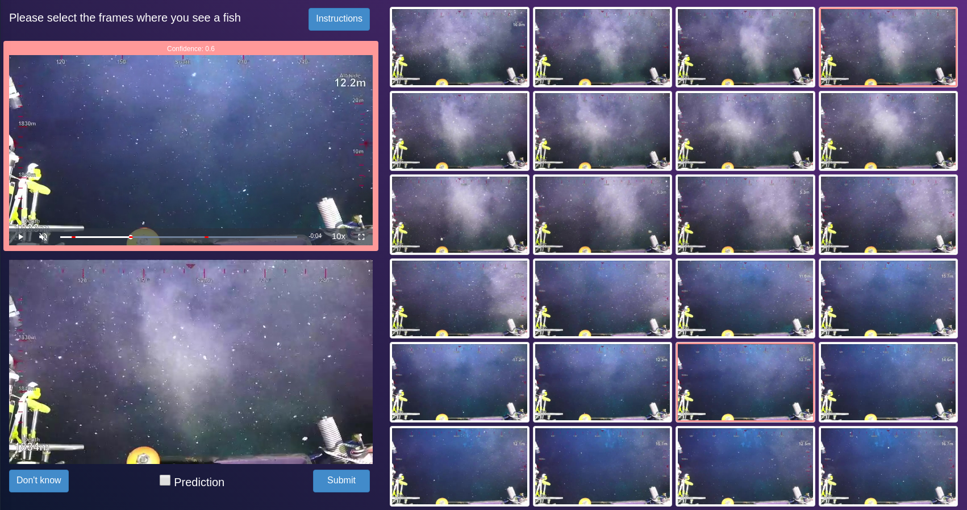
Now to the fish dataset!
We created a tool to label one minute video segments at a time.

Slide 28
From images to videos
Image Segment
Combine frame scores using mean/min to get the segment score.
Pred. Ent.
Pred. Ent.
Pred. Ent.
Pred. Ent.
Segment Score

Slide 29
Dataset
Assign different videos from 2012 to train, val and oracle.
Assign videos from 2008 to test.
Randomly sample video segments.
Unbalanced. Only 2 video segments in the test and val sets depict fish.
Large intra-class variability.
661 segments
39087 images
Train:
50 segments
2903 imgs.
(4.2%)
Val:
61 segments
3611 imgs.
(0.6%)
Oracle:
500 segments
29594 imgs.
(0.8%)
Test:
50 segments
2979 imgs.
(1.3%)

Slide 30
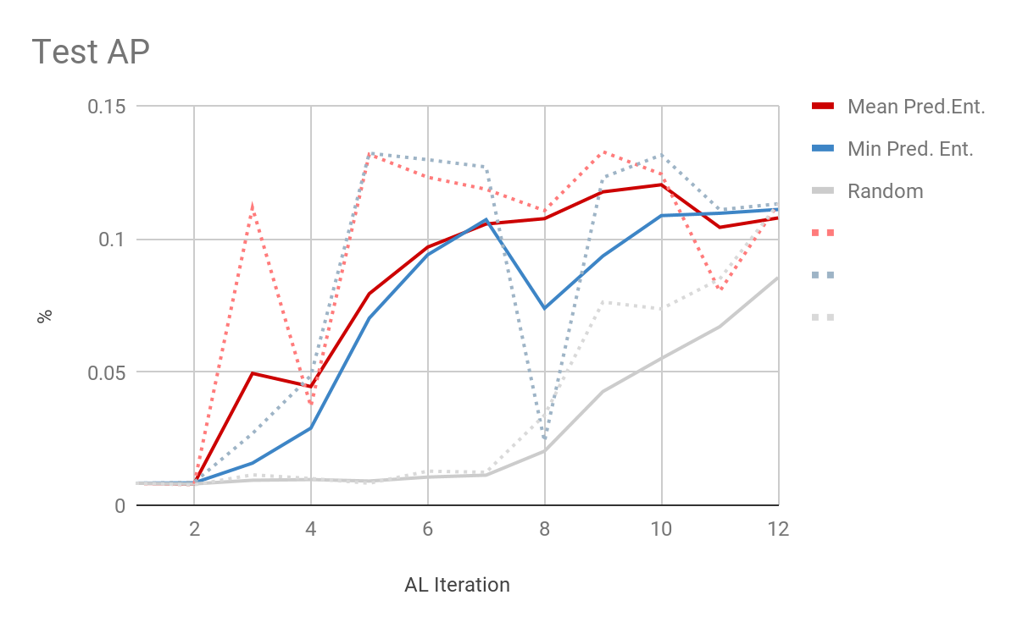
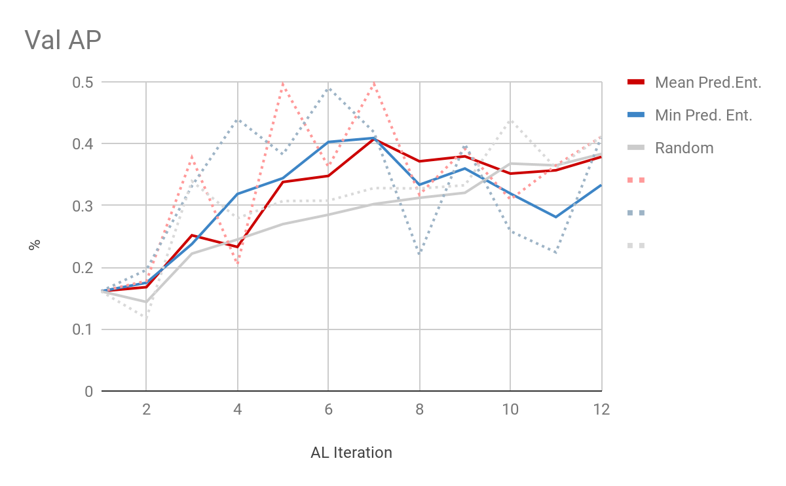
Results
ResNet50 pre-trained on ImageNet;
Sampling 50 segments at each iteration.

Slide 31
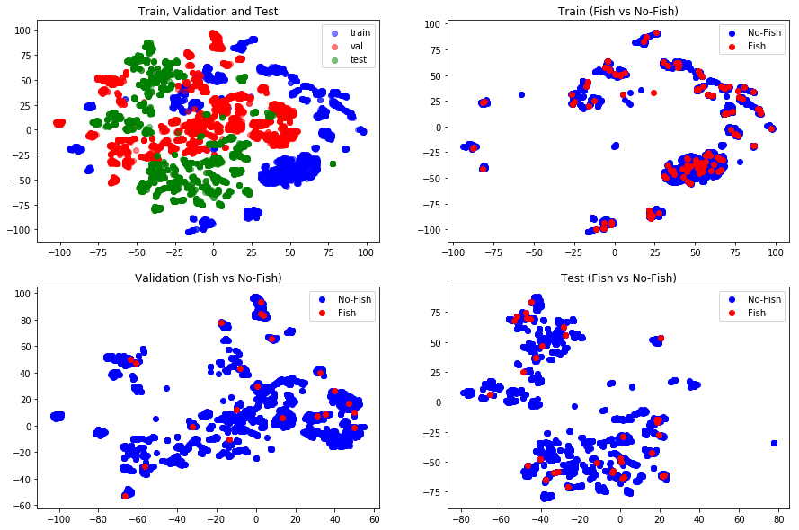
t-SNE on the features
train/val/test features are very different!
This coupled with high intra-class variability may explain low performance.
More data and semi-supervised methods may be able to help...

Slide 32
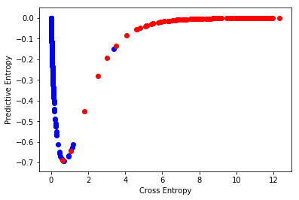
Caution!
Fish images are being wrongly classified with absolute certainty!

Slide 33
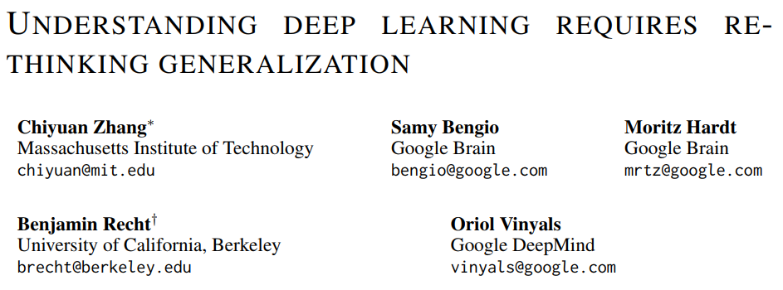
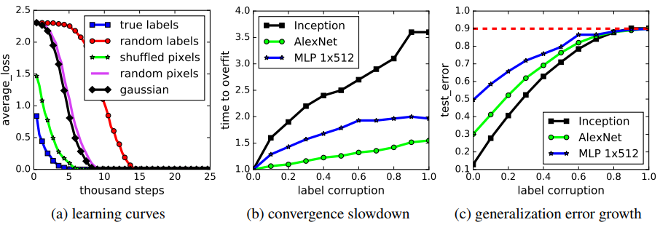
Deep Magic
Deep Learning methods can fit a dataset with random labels (even with regularization)!!!
Maybe Predictive Entropy is not the optimal sampling strategy.
Notes:
Deep Learning learns to extract features. The features are all wrong

Slide 34
AL from the start
53236 labeled frames.
Sampled segments are divided into train/val, making sure that there are no segments from the same video on different sets.
Potential Problem: val set is biased.
 | New Dataset | Old Dataset
Pos. Imgs. (%) | 6.07% | 1.0%
Val AP | 70.6% | 49.5%
Val AUC | 90.1% | 97.3%

Slide 35
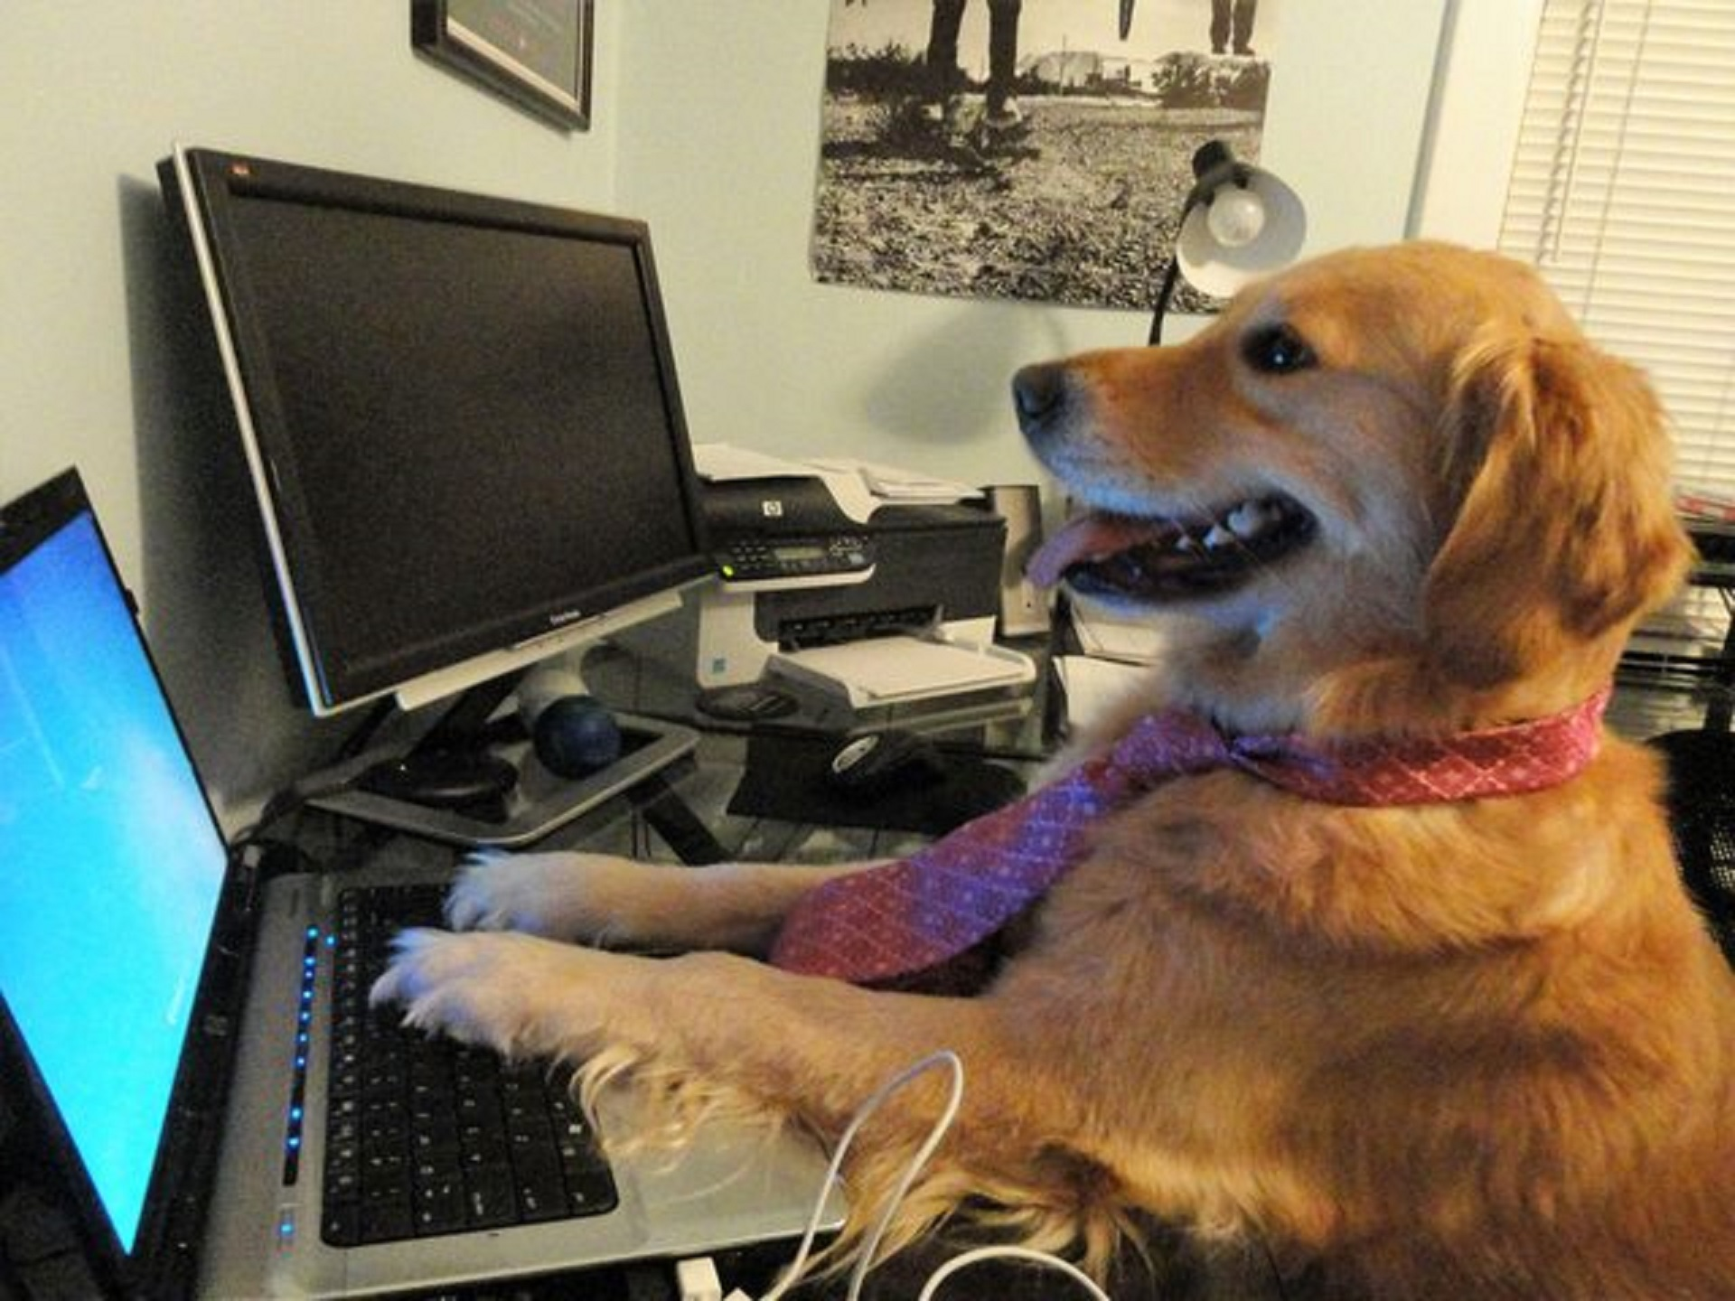
Future Work
Move from heuristic-based sampling to learned sampling functions.
Generative model on the feature space;
Learn what regions of the feature space are more prone to error;
Predict model improvements after adding the example to the training set.
Label more data.

Slide 36
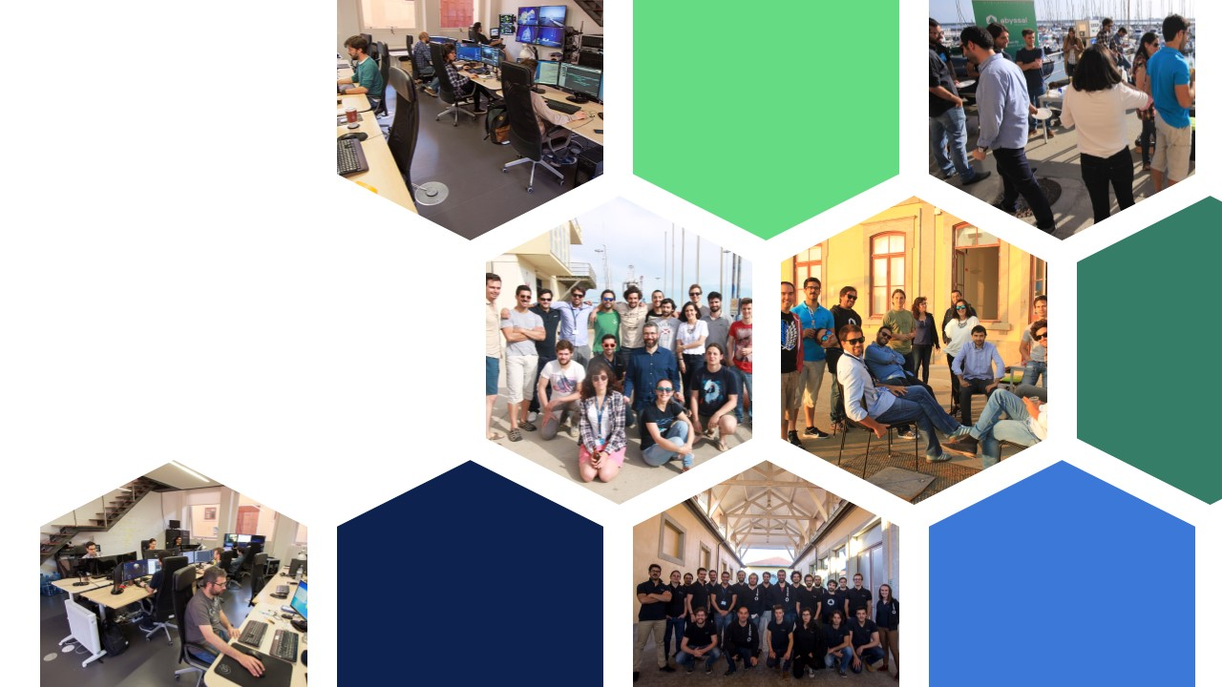
We are hiring!
Notes:
Se gostaram da Abyssal, a boa notícia é que estamos a contratar, tanto para desenvolvimento de software, artistas 3D entre outras posições como também para investigação em Machine Learning e Visão.

Slide 37
Notes:
Também podem visitar o nosso site e entrar em contacto connosco. Obrigado.

